Slide 1
What Else is new besides
training videos? OUR NEW NAME!

Slide 2



STRUCTURE OF THE BARNARD CENTER
Dissemination
Research
Workforce
Development
Notes:
PCRP is still an independent, self-sustaining arm of the Barnard Center

Slide 3
INTRODUCTION TO NCAST PCI
FEEDING & TEACHING SCALES
35 minutes – Presented by Dr. Monica Oxford
New? More clearly emphasizes the core concepts of Infant Mental Health that are embedded in Dr. Barnard’s Feeding and Teaching scales
Foundational information to have before moving on to learning the scales
Could also be used as an introduction to learning about the importance of the dyadic dance with others that are not going on to learn the scales

Slide 4

INFANT CUES
16 MINUTES
OVERVIEW
F SCALE
6 MINUTES

Slide 5


SENSITIVITY TO CUES SUBSCALE – 15 MIN
Page 60
Page 59
3-Month-Old and Mother
Breastfeeding
2:53 Minutes

Slide 6
RESPONSE TO DISTRESS SUBSCALE
8 MINUTES
Page 66
Page 65
4-Month-Old and Mother
Breastfeeding
2:20 Minutes

Slide 7

SOCIAL-EMOTIONAL GROWTH FOSTERING SUBSCALE – 9 MINS
Page 71
Page 72
6-Month-Old and Mother
Breastfeeding
1:28 Minutes

Slide 8
COGNITIVE GROWTH FOSTERING SUBSCALE – 10 MINS
PAGE 77
PAGE 78
12-Month-Old and Mother
Solid Feeding
2:37 Minutes

Slide 9
CLARITY OF CUES SUBSCALE -
11 MINS
PAGE 83
PAGE 84
4-Month-Old and Mother
Breastfeeding
2:23 Minutes

Slide 10

RESPONSIVENESS TO
CAREGIVER SUBSCALE – 8 MINS
PAGE 90
PAGE 89
4-Month-Old and Mother
Breastfeeding
2:16 Minutes

Slide 11
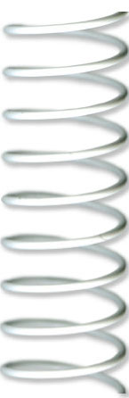

PAGE 25
PAGE 25
FEEDING PRACTICE
ANAYA
2-MONTH-OLD BREASTFEEDING

Slide 12



PAGE 27 FEEDING PRACTICE
JOHAN 5-MONTH-OLD BREASTFEEDING
PAGE 29 FEEDING PRACTICE
TEDEO-9 MONTH-OLD BOTTLE FEEDING
PAGE 31 FEEDING PRACTICE
CAROLINE 12-MONTH-OLD SOLID FEEDING

Slide 13
NCAST TEACHING SCALE

Slide 14
INFANT CUES
16 MINUTES
OVERVIEW T SCALE
12 MINUTES
Notes:
Same as before, if it’s been a while since they learned the Feeding scale OR if you are doing the T scale first, be sure to watch the introduction (35 mins) of Monica, Watch Infant Cues again, and begin with T scale overview.

Slide 15

SENSITIVITY TO CUES SUBSCALE
– 18 MINS
Page 54
Page 53
27-Month-Old and Mother
Pull zipper up and down
:54 Seconds
Notes:
If you have the

Slide 16
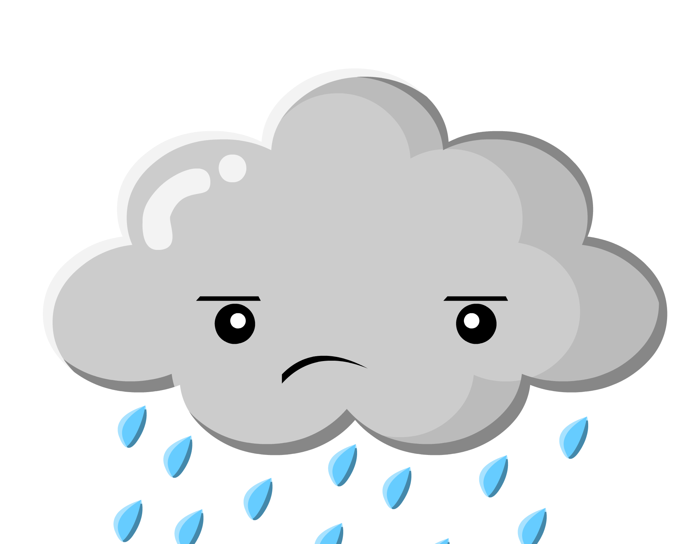
RESPONSE TO DISTRESS SUBSCALE
- 8 MINS
Page 59
Page 60
28-Month-Old and Mother
Draw a shape (circle)
1:55 Minutes

Slide 17
SOCIAL-EMOTIONAL GROWTH FOSTERING SUBSCALE
- 11 MINS
Page 66
Page 65
3-Month-Old and Mother
Hold the rattle
1:17 Minutes

Slide 18

COGNITIVE GROWTH FOSTERING SUBSCALE – 28 MINS
Page 73
Page 74
29-Month-Old and Mother
Draw a shape (square)
1:48 Minutes
Notes:
THIS IS THE ONLY SUBSCALE THAT IS SIGNIFICANTLY LONGER THAN THE PREVIOUS VIDEO. . . ABOUT 10 MINS MORE THAN THE PREVIOUS VERSION.

Slide 19

OF CUES SUBSCALE- 6 MINS
Page 80
Page 79
12-Month-Old and Mother
Take lid off container
2:01 Minutes

Slide 20
RESPONSIVENESS TO CAREGIVER SUBSCALE – 15 MINS
Page 85
Page 85
21-Month-Old and Father
Button the button
1:26 Minutes
Serve & Return

Slide 21
PAGE 56
TEACHING PRACTICE #1
STELLA
3-MONTH-OLD
TRANSFER BLOCK

Slide 22
PAGE 58 - PRACTICE #2
11 MONTHS OLIVIA – PULL CAR BY STRING
PAGE 60 - PRACTICE #3
21 MONTHS ANDRE – PUT BEADS ON STRING
PAGE 62 - PRACTICE #4
36 MONTHS GABRIEL – CUT SHAPE W/ SCISSORS

Slide 23
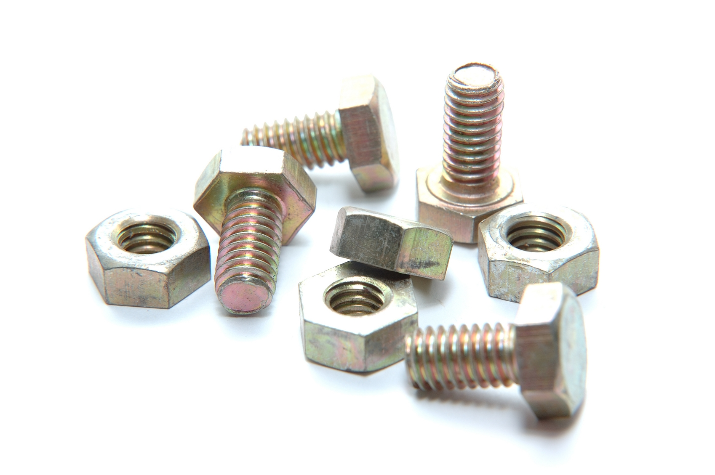
PUTTING IT ALL TOGETHER!

Slide 24

WHAT’S INSIDE THE NEW VIDEO CASE?
Notes:
Outside cover

Slide 25
INSIDE YOUR NCAST PCI VIDEO CASE
#1 Instruction
#3 Resources
#2 Reliability
Notes:
IT WILL SAY “INSTRUCTION” ON THE DRIVE ON YOUR DESKTOP. OR RELIABILITY OR RESOURCES. ALL instruction items will be on this disc: intro, cues, both scales and practice videos for both scales. Reliability is to be kept separately and secure. Resources is like your old CD, with logos, images, PowerPoint templates, rosters, forms, handouts, directions. There is a new learner folder with all you need for a new class, a recertification folder with what you need, and
DO NOT DELETE ANYTHING. THEY ARE NOT “UNDELETABLE”. IF YOU DELETE THE FILES, THEY ARE GONE!
Please destroy and recycle your old DVDs after you make the transition. You do not need to return them to us.

Slide 26





Browsers that work with PCI USB drives:
Notes:
If your default is Chrome, you will need to right click and choose “open with”. You do NOT need the internet, just one of the browsers to open the video files.

Slide 27

Let’s navigate the drives together. . .
Notes:
Put in your drives and practice navigating and finding what you want. It is NOT chaptered. It is not a viable function in this format.

Slide 28
“I’M SO USED TO THE ‘OLD’ VIDEOS, I’M HESITANT TO JUMP IN!”
Getting Started. . .
Start by watching the Introduction and Cues before you teach. Some of the areas/education you may have been offering AFTER watching the videos previously will be covered in the new videos.
Watch each subscale and practice video. Stop and start at the time points that are examples for why the answer is what it is.
Remember, there may be more reasons as to why the answer is what it is; we give you examples and the list may or may not be inclusive.
Watch the practice videos and look for the time stamps. Rely on those for teaching; just like you do now. “Let’s go back and look together” and “let’s go back and read the item.”
Notes:
How do you eat an elephant? One bite at a time.

Slide 29
HOW DO WE MAKE THE TRANSITION?
YOU MAY SUBMIT RELIABILITIES FROM THE “OLD” VIDEOS UNTIL JANUARY 1, 2019
ONLY RELIABILITIES CODED WITH THE “NEW” VIDEOS WILL BE ACCEPTED AFTER THAT DATE
IF YOU WISH TO USE THE OLD MANUALS WITH THE NEW VIDEOS, YOU MAY PRINT THE “NEW SUBSCALE ANSWERS” FROM YOUR RESOURCE USB DRIVE, IN THE “NEW LEARNER” FOLDER AND USE THE ONES YOU HAVE IN STOCK
PUT “NEW” OR “OLD” AT THE TOP OF THE CLASS ROSTER AND RELIABILITY FORMS WHEN SENDING THEM IN TO OUR OFFICE
Notes:
Classes in November or December that come in to the office in January are fine. IF YOU HAVE A SPECIAL NEED OR REQUEST, PLEASE CONTACT OUR OFFICE ABOUT NEW VS OLD VIDEOS FOR TEACHING.
They can still use the box to score the dyad. Give them the new information on each, age, task, length of time. Handout the subscale practice answers after they have scored rather than have them turn the page to check. Write “new” or “old” at the top of your class roster AND on the reliability form.

